Slide 1

Our Internship Experience at Metnee Systems PLC: Developing Sheqlee
Welcome to our presentation! We are excited to share our internship experience at Metnee Systems PLC. Over the past months, we've contributed to the development of Sheqlee, a comprehensive freelancing platform. This presentation will cover our roles, contributions, challenges, and key learnings.

Slide 2

Internship Overview
1
Course Requirement
2
Sheqlee Development
3
Key Areas
This internship was a course requirement from Nov 01/2024 - Jan 30/2025 GC.
We contributed to the development of Sheqlee, a comprehensive freelancing platform.
Our presentation will cover roles, contributions, challenges, and key learnings.

Slide 3




About Metnee Systems PLC
Software Development
IT Consulting
Digital Transformation
Providing expert IT consulting and strategic planning.
Specializing in software development solutions.
Offering services for digital transformation.
Metnee Systems PLC is a leading technology company. Their mission is to deliver innovative and scalable solutions to businesses.

Slide 4





Presentation Roadmap
Company Overview
Sheqlee: Project Overview
Roles and Responsibilities
Challenges and Solutions
Key Learnings

Slide 5
Metnee Systems PLC: A Closer Look
Founded
Commitment
Industry Focus
Reputation
Dedicated to delivering tailored and innovative solutions.
Committed to excellence in diverse industries.
Serving finance, healthcare, education and e-commerce sectors.
Renowned for expertise in cloud, AI and cybersecurity.

Slide 6

Products and Services Offered
Custom Software
Tailored software addressing specific business needs.
IT Consulting
Expert guidance for digital transformation goals.
System Integration
Seamless integration ensuring security and interoperability.
App Development
Responsive web and mobile apps for iOS and Android.

Slide 7



Clients & Organization
Sectors
2
Diverse sectors like healthcare and finance.
Clients
1
Serving businesses and government institutions.
Workflow
3
Agile methodology promotes seamless project flow.

Slide 8



Sheqlee: Key Features
Seamless Experience
Dedicated Accounts
Streamlined Process
User-friendly design for businesses and freelancers on web and mobile.
Separate accounts enhance connections, collaboration, and project oversight.
Simplifying hiring and collaboration for all users.

Slide 9
Addressing Market Challenges
Cost-Effectiveness
Enhanced Trust
Intuitive Design
Sheqlee offers lower fees compared to other freelance platforms.
Our platform fosters transparency. This builds trust between users.
Sheqlee has a user-friendly interface. It simplifies job discovery.

Slide 10
Sheqlee: Advanced Features
1
Secure Accounts
2
Job Management
3
Job Discovery
We offer role-based access controls. Also, multi-factor authentication adds to security.
Companies manage jobs. They use tools for postings and communicating with candidates.
Freelancers use AI-powered recommendations. Our search helps them find opportunities easily.

Slide 11
Sheqlee: Core Capabilities
1
Seamless Applications
2
Unified Experience
Candidates can apply and manage applications smoothly. Notifications keep everyone informed.
Sheqlee delivers a uniform user experience. This covers web and mobile devices.
3
Secure Payments
4
Performance Analytics
The platform has an integrated payment system. It supports escrow and milestone payments.
Data insights enable better decisions. This optimizes activities for companies and freelancers.

Slide 12
Sheqlee: Tech Stack & CI/CD
Front-End: React
Mobile: Flutter
Back-End: Node.js
CI/CD Pipeline
Sheqlee uses React to create a dynamic user interface.
Flutter enables cross-platform development for mobile.
Node.js builds Sheqlee's robust back-end architecture.
Automated pipeline ensures efficient delivery of updates.

Slide 13
Sheqlee: Scalability & Security
Scalability
Security
Reliability
Our cloud architecture scales to meet data and user growth.
We employ authentication and vulnerability protection.
Our customers enjoy a stable and secure platform.

Slide 14
Sheqlee: Development Workflow
Agile Methodology: Iterative development and quick feedback cycles.
Dedicated Teams: Frontend, backend, and mobile app experts collaborate closely.
Workflow Highlights: Daily stand-ups, sprint planning, code reviews, and automated CI/CD.
Nimble Approach: Quick response to changes, ensuring high-quality software delivery.

Slide 15




Our Roles and Responsibilities
Frontend Developer
Frontend Developer
Mobile App Developer
Backend Developer
We crafted intuitive interfaces using React. Our goal was a seamless user experience.
Collaborating with designers, we ensured the interfaces matched requirements.
We created cross-platform mobile apps with Flutter. These apps matched our web standards.
We built secure APIs using Node.js. This ensured that data flowed smoothly.

Slide 16
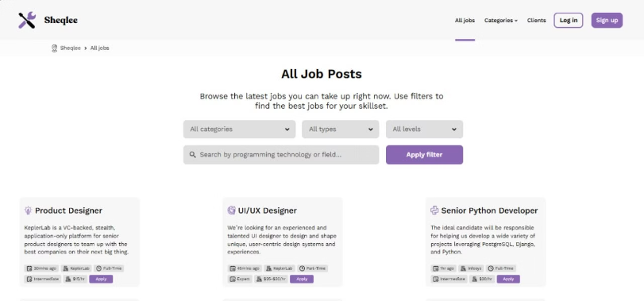
Frontend Contributions
Developed Interfaces
I built responsive web interfaces with React. These interfaces are user-friendly.
Interactive Components
I created UI components. These interactive components enhance user experience.
API Integration
I successfully integrated RESTful APIs. These APIs ensure real-time data handling.

Slide 17
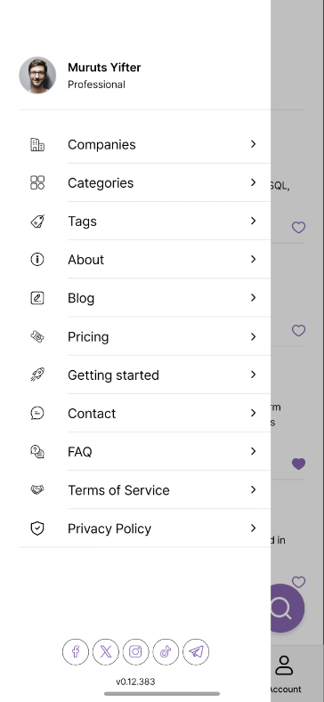
Our Mobile App Contributions
Developed Key Features
We used Flutter and Dart to make core app features.
Integrated Notifications
Real-time notifications and in-app messages were added.
Ensured Compatibility
The app is compatible across many device resolutions.

Slide 18
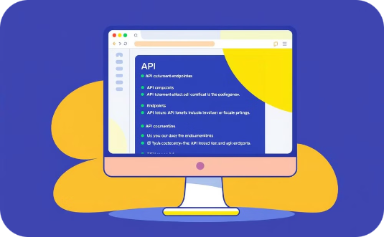
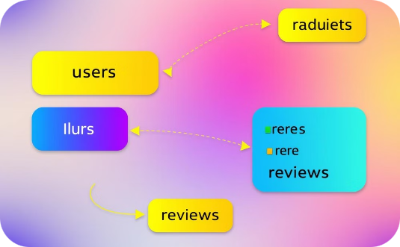
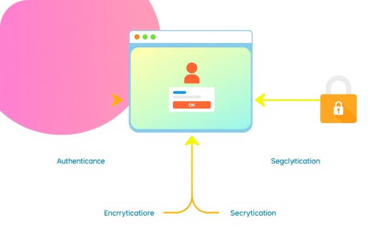
Back-End Contributions
RESTful APIs
Database Schemas
Authentication
I developed robust APIs using Node.js. These ensured smooth data flow.
We designed efficient database schemas. They supported scalability and quick access.
User roles and authorization were managed. This guaranteed system security.

Slide 19
Achievements and Results
1
Registration
2
Login
The new registration feature passed all tests. This ensures smooth onboarding for new users.
Login functionality is secure and reliable. This provides users with safe platform access.
3
Job Management
4
Job Searching
Company job management flows are streamlined. Companies can post and manage jobs with ease.
Job search filters are effective and efficient. Job seekers quickly find relevant positions.

Slide 20
Challenges Faced
1
Adapting to New Technologies
2
Understanding Complex Codebases
We learned Flutter and advanced React patterns quickly. This allowed us to be productive.
We navigated a large-scale project. The project had multiple dependencies.
3
Managing Multiple Tasks
4
Debugging Cross-Platform Issues
We balanced development responsibilities. We did this while meeting tight deadlines.
We addressed inconsistencies. These were between web and mobile versions.

Slide 21
How We Overcame Challenges
1
Self-Learning & Research
2
Seeking Mentorship
We dove into online courses and documentation. We also utilized coding tutorials to grasp new concepts.
We frequently consulted senior developers. They provided invaluable guidance and insights.
3
Task Prioritization
4
Collaboration & Code Reviews
We used Jira to organize and manage tasks effectively. This ensured we met deadlines.
We engaged in peer reviews and pair programming. This improved code quality.

Slide 22
Key Lessons Learned
1
User-Centric Design
2
Agile Methodology
3
Collaboration
Prioritize ease of use. This is essential for platform adoption and user satisfaction.
Iterative development with feedback enables continuous improvement and adaptability.
Teamwork across frontend, backend, and mobile drives success and innovation.

Slide 23
Theoretical Knowledge
Agile Development: We grasped Agile and Scrum. These are vital for iterative development.
System Architecture: We learned MVC and RESTful APIs. These enhance application design and scalability.
Frontend, Backend, and Databases: We now understand these interactions. This knowledge supports full-stack development.

Slide 24
Benefits and Skills Gained
1
Mobile App Expertise
2
Debugging Prowess
3
Algorithm Proficiency
Proficiency in mobile app development with Flutter increased. Skills in UI/UX and state management were strengthened.
Advanced debugging capabilities were refined. This helped solve complex issues across platforms efficiently.
Algorithm design and optimization skills improved. This led to effective and scalable solutions.

Slide 25
Benefits and Skills Gained
1
Teamwork and Problem-Solving
2
Industrial Problem-Solving
3
Professionalism and Work Ethic
Collaboration and communication skills improved significantly. We worked together and solved complex issues.
We tackled real-world business challenges. This enabled us to develop innovative solutions.
We grew to understand punctuality, accountability, and respect. These are all important in the workplace.

Slide 26
Conclusion
1
Transformative Experience
2
Sheqlee Development
Our internship at Metnee Systems PLC was truly transformative.
We significantly contributed to Sheqlee's development.
3
Valuable Skills
4
Gratitude
We gained technical skills and problem-solving abilities.
Thank you to Metnee and Mekelle University.

Slide 27
Q&A
Thank you for your attention. We welcome any questions about our internship and Sheqlee.
1
Open Discussion
2
Deep Dive
3
Clarifications
We're ready to address your questions. We will provide thorough and insightful answers.
Feel free to dive deep into any area. We can discuss tech, challenges, or future plans.
We can provide further clarification on any topic. We'll ensure everyone understands key points.

